Slide 1
C++ Arithmetic operators
Kusal Bista

Slide 2

C++ Operators
Operators are used to perform operations on variables and values.
C++ divides the operators into the following groups:
Arithmetic operators
Assignment operators
Comparison operators
Logical operators
Bitwise operators

Slide 3
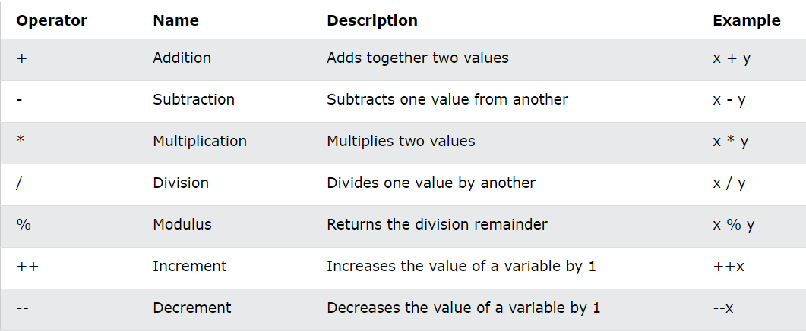
Arithmetic operators

Slide 4
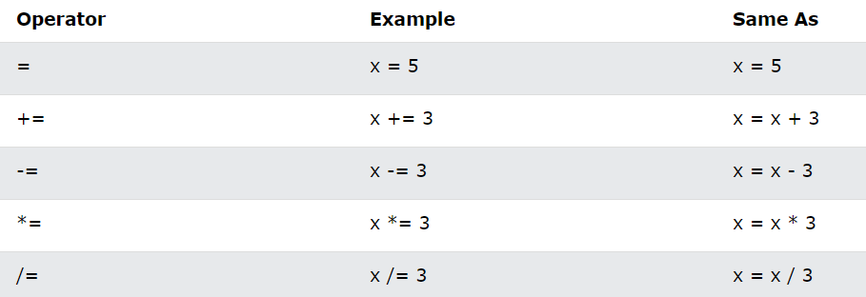
Assignment Operators
Assignment operators are used to assign values to variables.

Slide 5
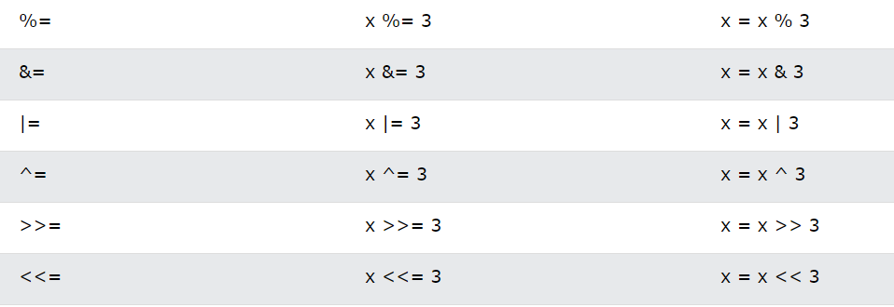
Assignment Operators

Slide 6
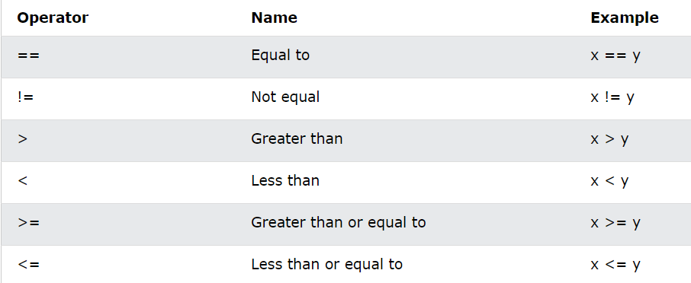
Comparison Operators
Comparison operators are used to compare two values.
The return value of a comparison is either true (1) or false (0).

Slide 7
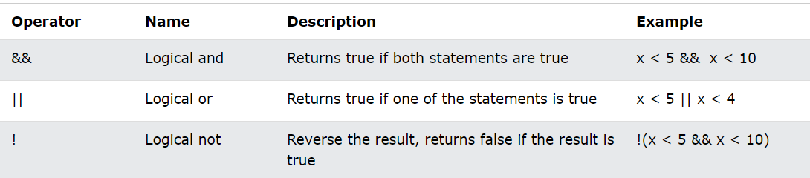
Logical Operators
Logical operators are used to determine the logic between variables or values:

